Slide 1
Task 14: Final Presentation

Slide 2
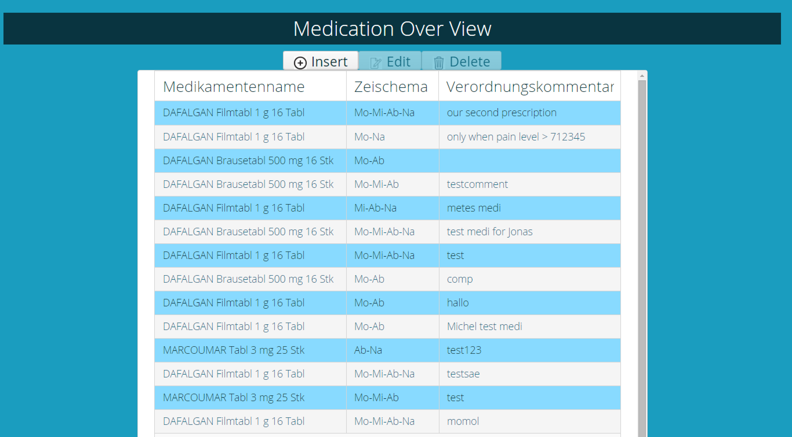
Demo

Slide 3
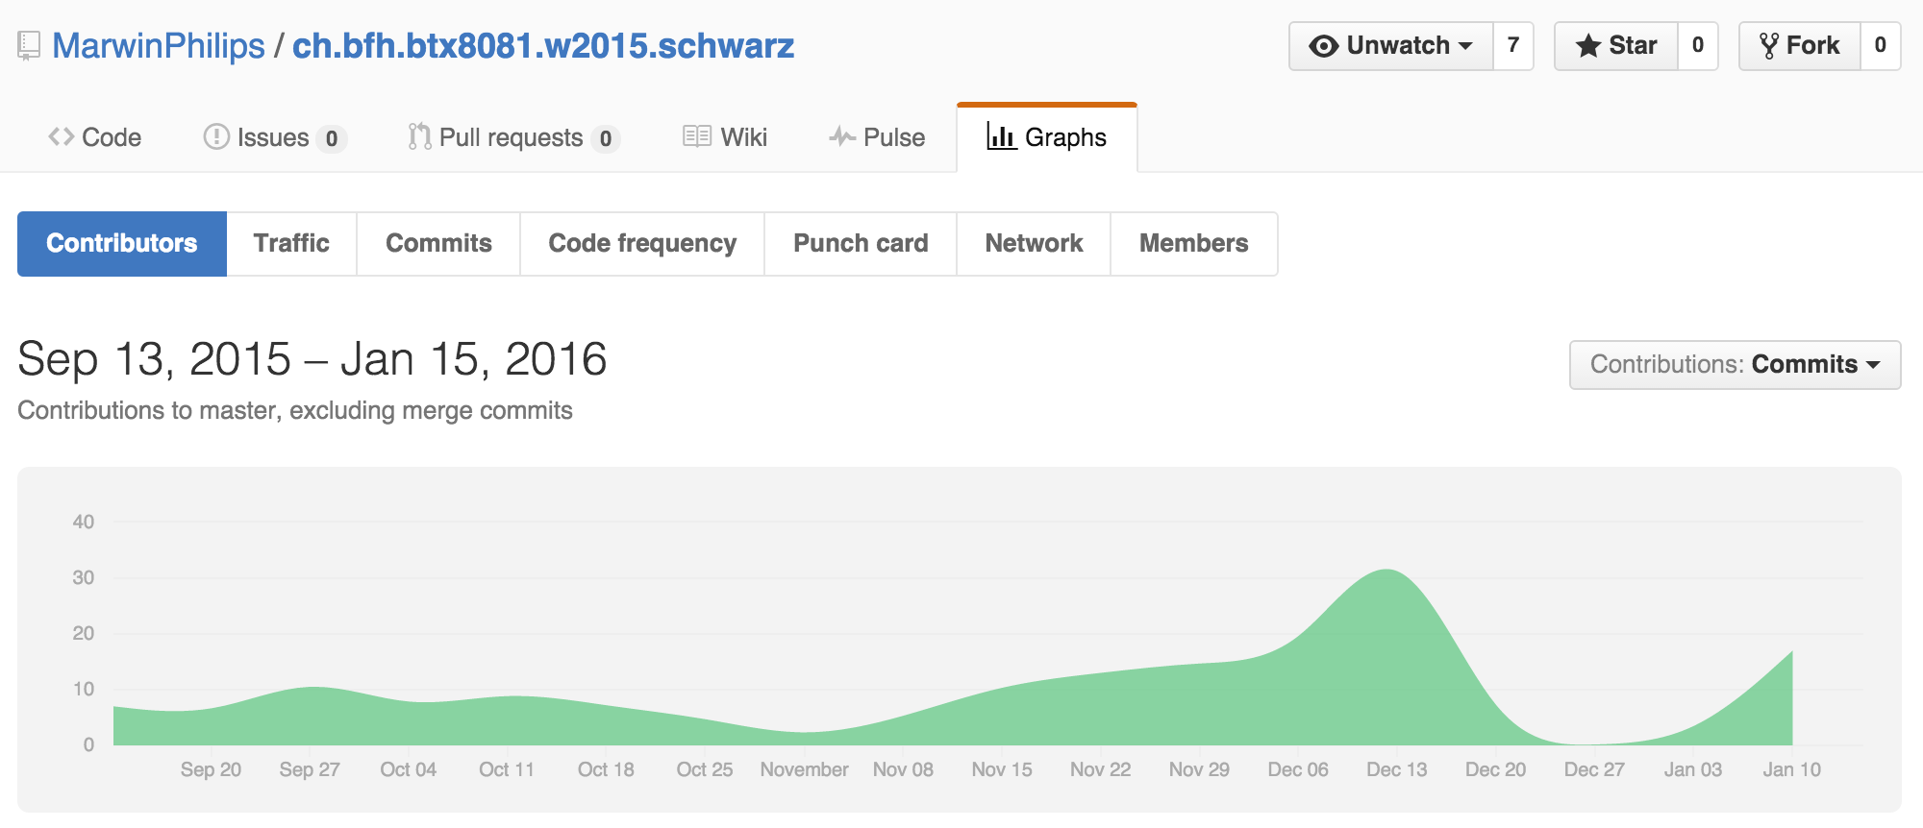
Contributions

Slide 4
<Platzhalter für jedes Teammitglied>

Slide 5
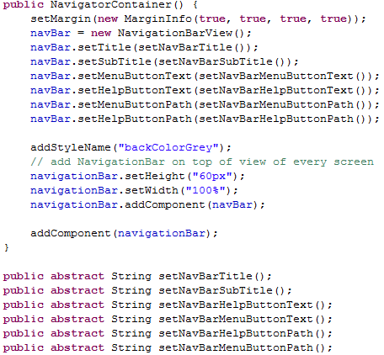
Contribution Jonas Mosimann
NavigationBar functionality
General Bugfixing
Tests for validation

Slide 6

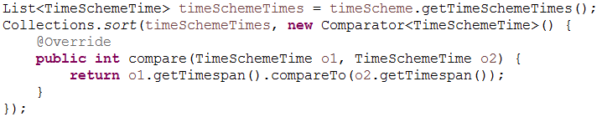
Contribution Marwin Philips
Database connectivity
General support for team members

Slide 7
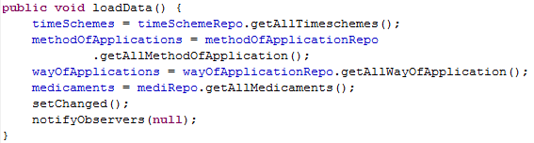
Contribution Mete Turna
Class: MedicationEditModel
Function: Read-, Edit- & Update Prescription
Methode: loadData()

Slide 8
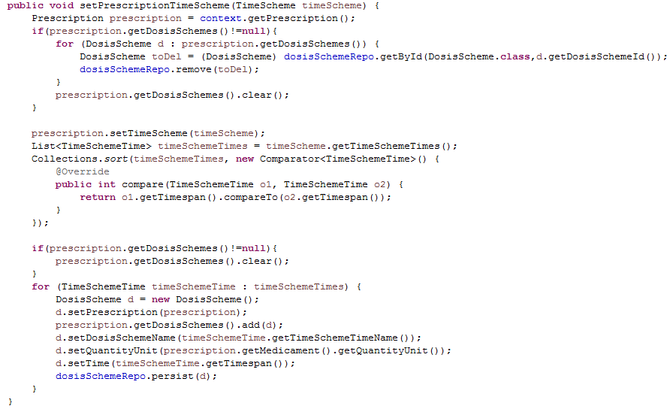
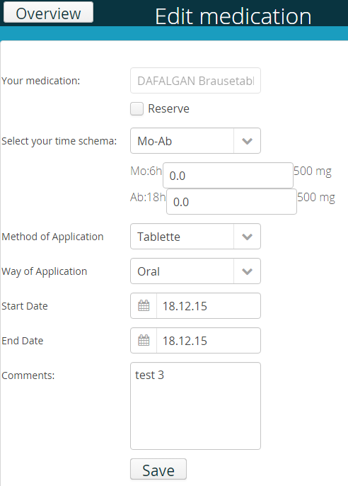
Contribution Mete Turna

Slide 9
Contribution Mete Turna
Classe: MedicationEditModel
Function: Read-, Edit- & Update-Prescription
Methode: loadData(), setPrescriptionTimeScheme(…)
Difficulties: Read & Update von PrescriptionTimeS.(…)
Validation:

Slide 10
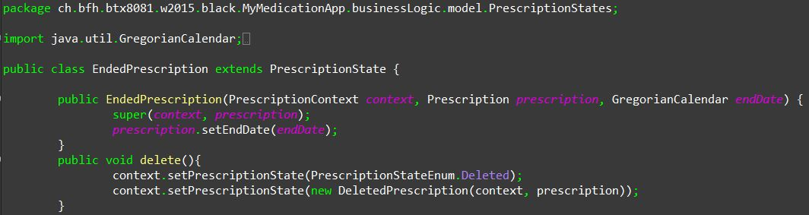
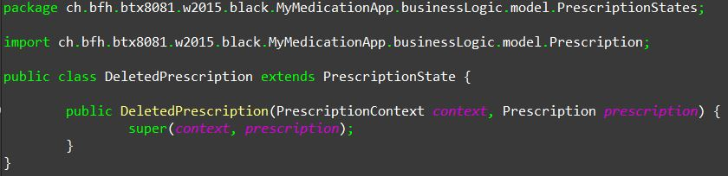
Contribution Michel Murbach
Deleting a new prescription
Aufruf der Methode

Slide 11
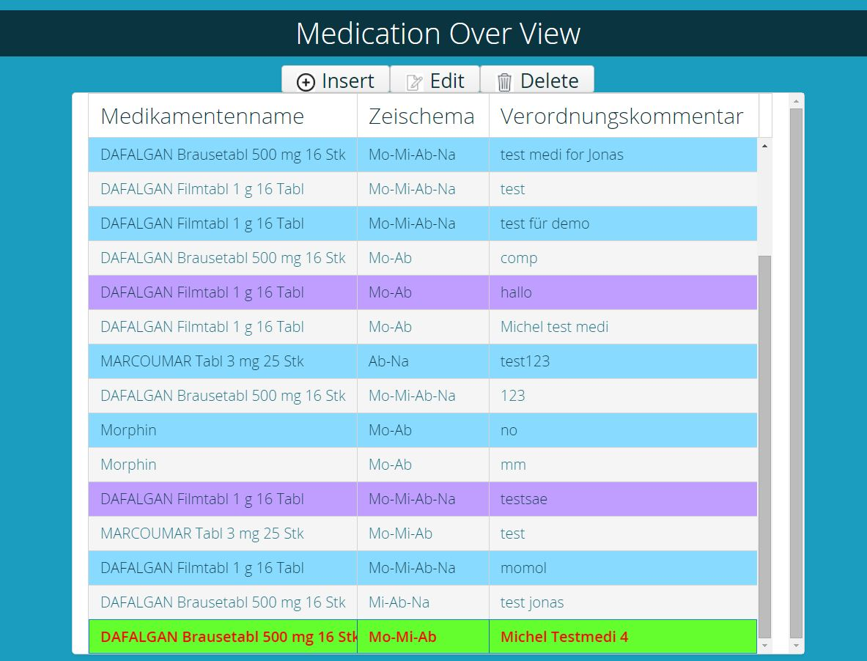
Contribution Michel Murbach
Deleting a new prescription

Slide 12
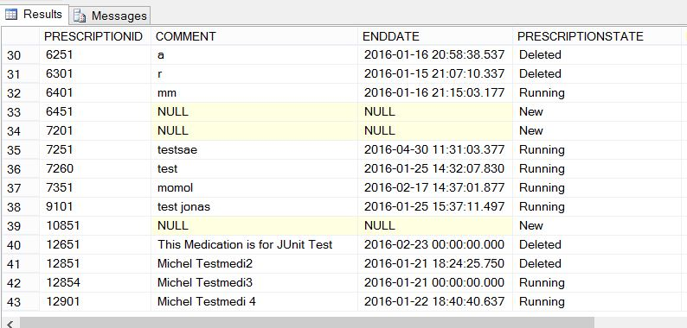
Contribution Michel Murbach
Deleting a new prescription

Slide 13
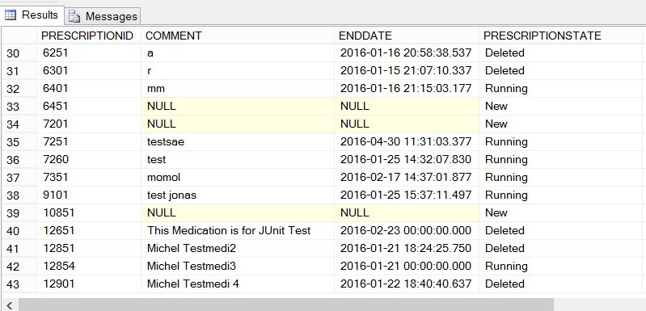
Contribution Michel Murbach
Deleting a new prescription

Slide 14
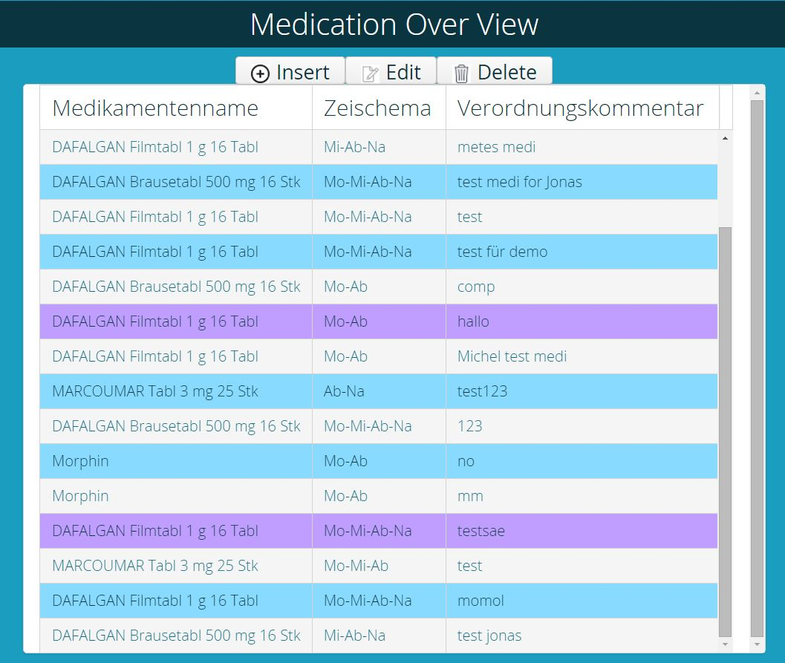
Contribution Michel Murbach
Deleting a new prescription

Slide 15
Contribution Carole Kaiser
Creating Overview of Medication
Styling all Element with mytheme.scss
Support / Pair Programming other Teammembers
Test Classes MsssqlRepository and PerscriptionRepository

